Slide 1
Introduction to Cloud Provisioning with Terraform

Slide 2
Introductions
Jason Harley jharley@redmind.ca @redmind https://www.linkedin.com/in/jharley/ https://github.com/jharley

Slide 3
A better way?
Terraform released in July 2014
Built to make provisioning infrastructure declarable and flexible
a universal workflow
strong ecosystem of supported integrations
mixing vendors’ solutions is possible with the same workflow and tooling
YAML and JSON… are often frustrating
HCL introduced

Slide 4
Terminology: a crash course
Providers offer technology integrations and functionality
largely by wrapping third-party APIs
Resources and Data Sources are made available via a Provider and are the building blocks used to codify and manage our infrastructure
made reusable via Modules
Terraform has State which is at the heart of it’s declarative nature and ability to manage the lifecycle of resources under it’s control
Terraform Variables serve as parameters to resources or modules
can be set at runtime, determined by a data source, or be configured on a per-environment basis to help keep code reusable and flexible

Slide 5

Terraform Workflow
Code
Apply
Plan
Terraform logo Copyright © 2019 Hashicorp

Slide 6
Scenario

Slide 7
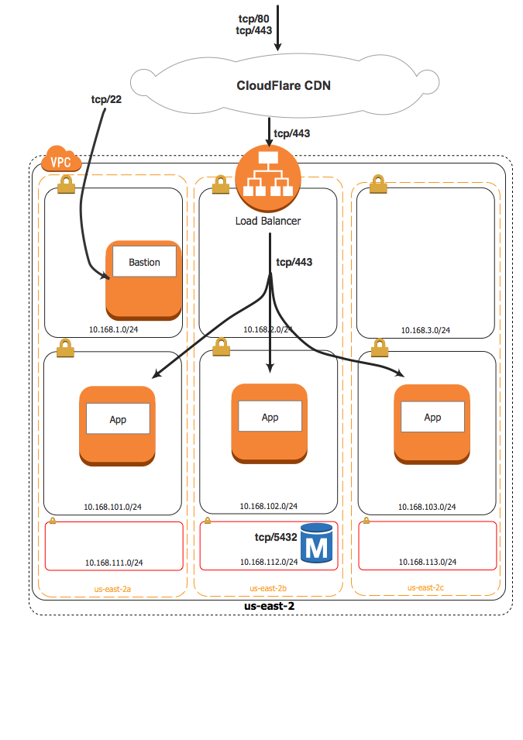

Slide 8
Okayokay… but
How?

Slide 9


Slide 10
Milestone 1
Flag on the Moon

Slide 11
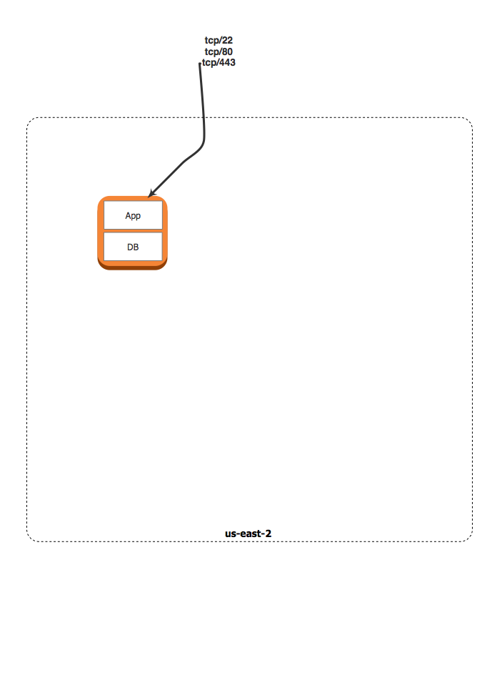

Slide 12
Milestone 2
VPCs with a little help from our friends?

Slide 13
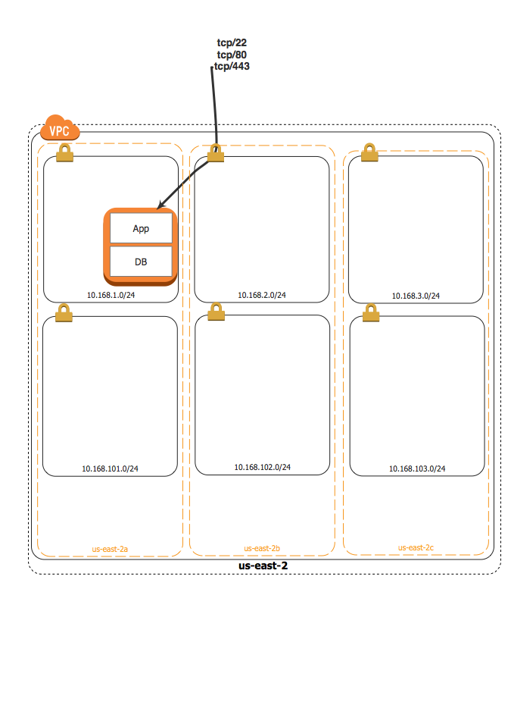

Slide 14
Milestone 3
Scalin’ up, and scalin’ out

Slide 15
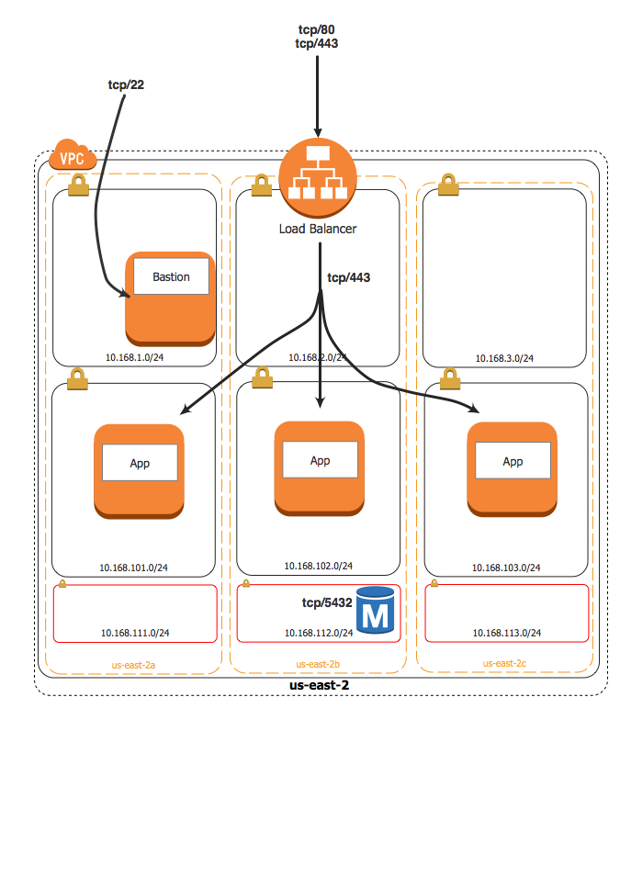

Slide 16
Milestone 4
#goals?

Slide 18
Next steps
Browse the documentation for the AWS Provider
Or for your cloud platform of choice
Read up on Remote State management
Essential for working in team!
Browse the Public Module Registry at registry.terraform.io
Many modules serve as a great starting place for your own code
Try writing your own “app” module
Have fun!

Slide 19
Questions?
Jason Harley jharley@redmind.ca @redmind https://www.linkedin.com/in/jharley https://github.com/jharley/terraform-intro

